Slide 1

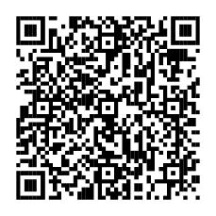
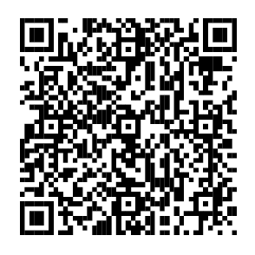
Get help managing your money—for your family, your community & yourself.
This Asian American, Native Hawaiian, and Pacific Islander Heritage Month, find tools and resources to help you reach your financial goals.
Learn more
Fidelity Brokerage Services LLC, Member NYSE, SIPC, 900 Salem Street, Smithfield, RI 02917
© 2026 FMR LLC. All rights reserved. 1245682.1.0

